Slide 1
Class DisplayImage
id_div_display_image_my_fctn_rec_x m_style_display_image = clear: both
id_div_display_image_group_icons_my_fctn style_display_image_group_icons = clear: both
id...._my_fctn_icon_four
m_style_icon_one =
float: right
id...._my_fctn_icon_three
m_style_icon_two =
float : right
id...._my_fctn_icon_two
m_style_icon_three =
float : right
id...._my_fctn_icon_one
m_style_icon _four =
float : right
id_div_display_image_picture_my_fctn m_style_picture = clear: both
id_div_group_all_texts_my_function group_all_texts_style_str clear both
id_div_group_one_text_my_function group_one_style_str clear: both
id_div_text_one_my_function
m_style_text_one = float: left
id_div_text_two_my_function
m_style_text_two = float: right
id_div_group_two_text_my_function group_two_style_str clear: both
id_div_text_three_my_function
m_style_text_three = clear: both
id_div_text_four_my_function
m_style_text_four = clear: both

Slide 2


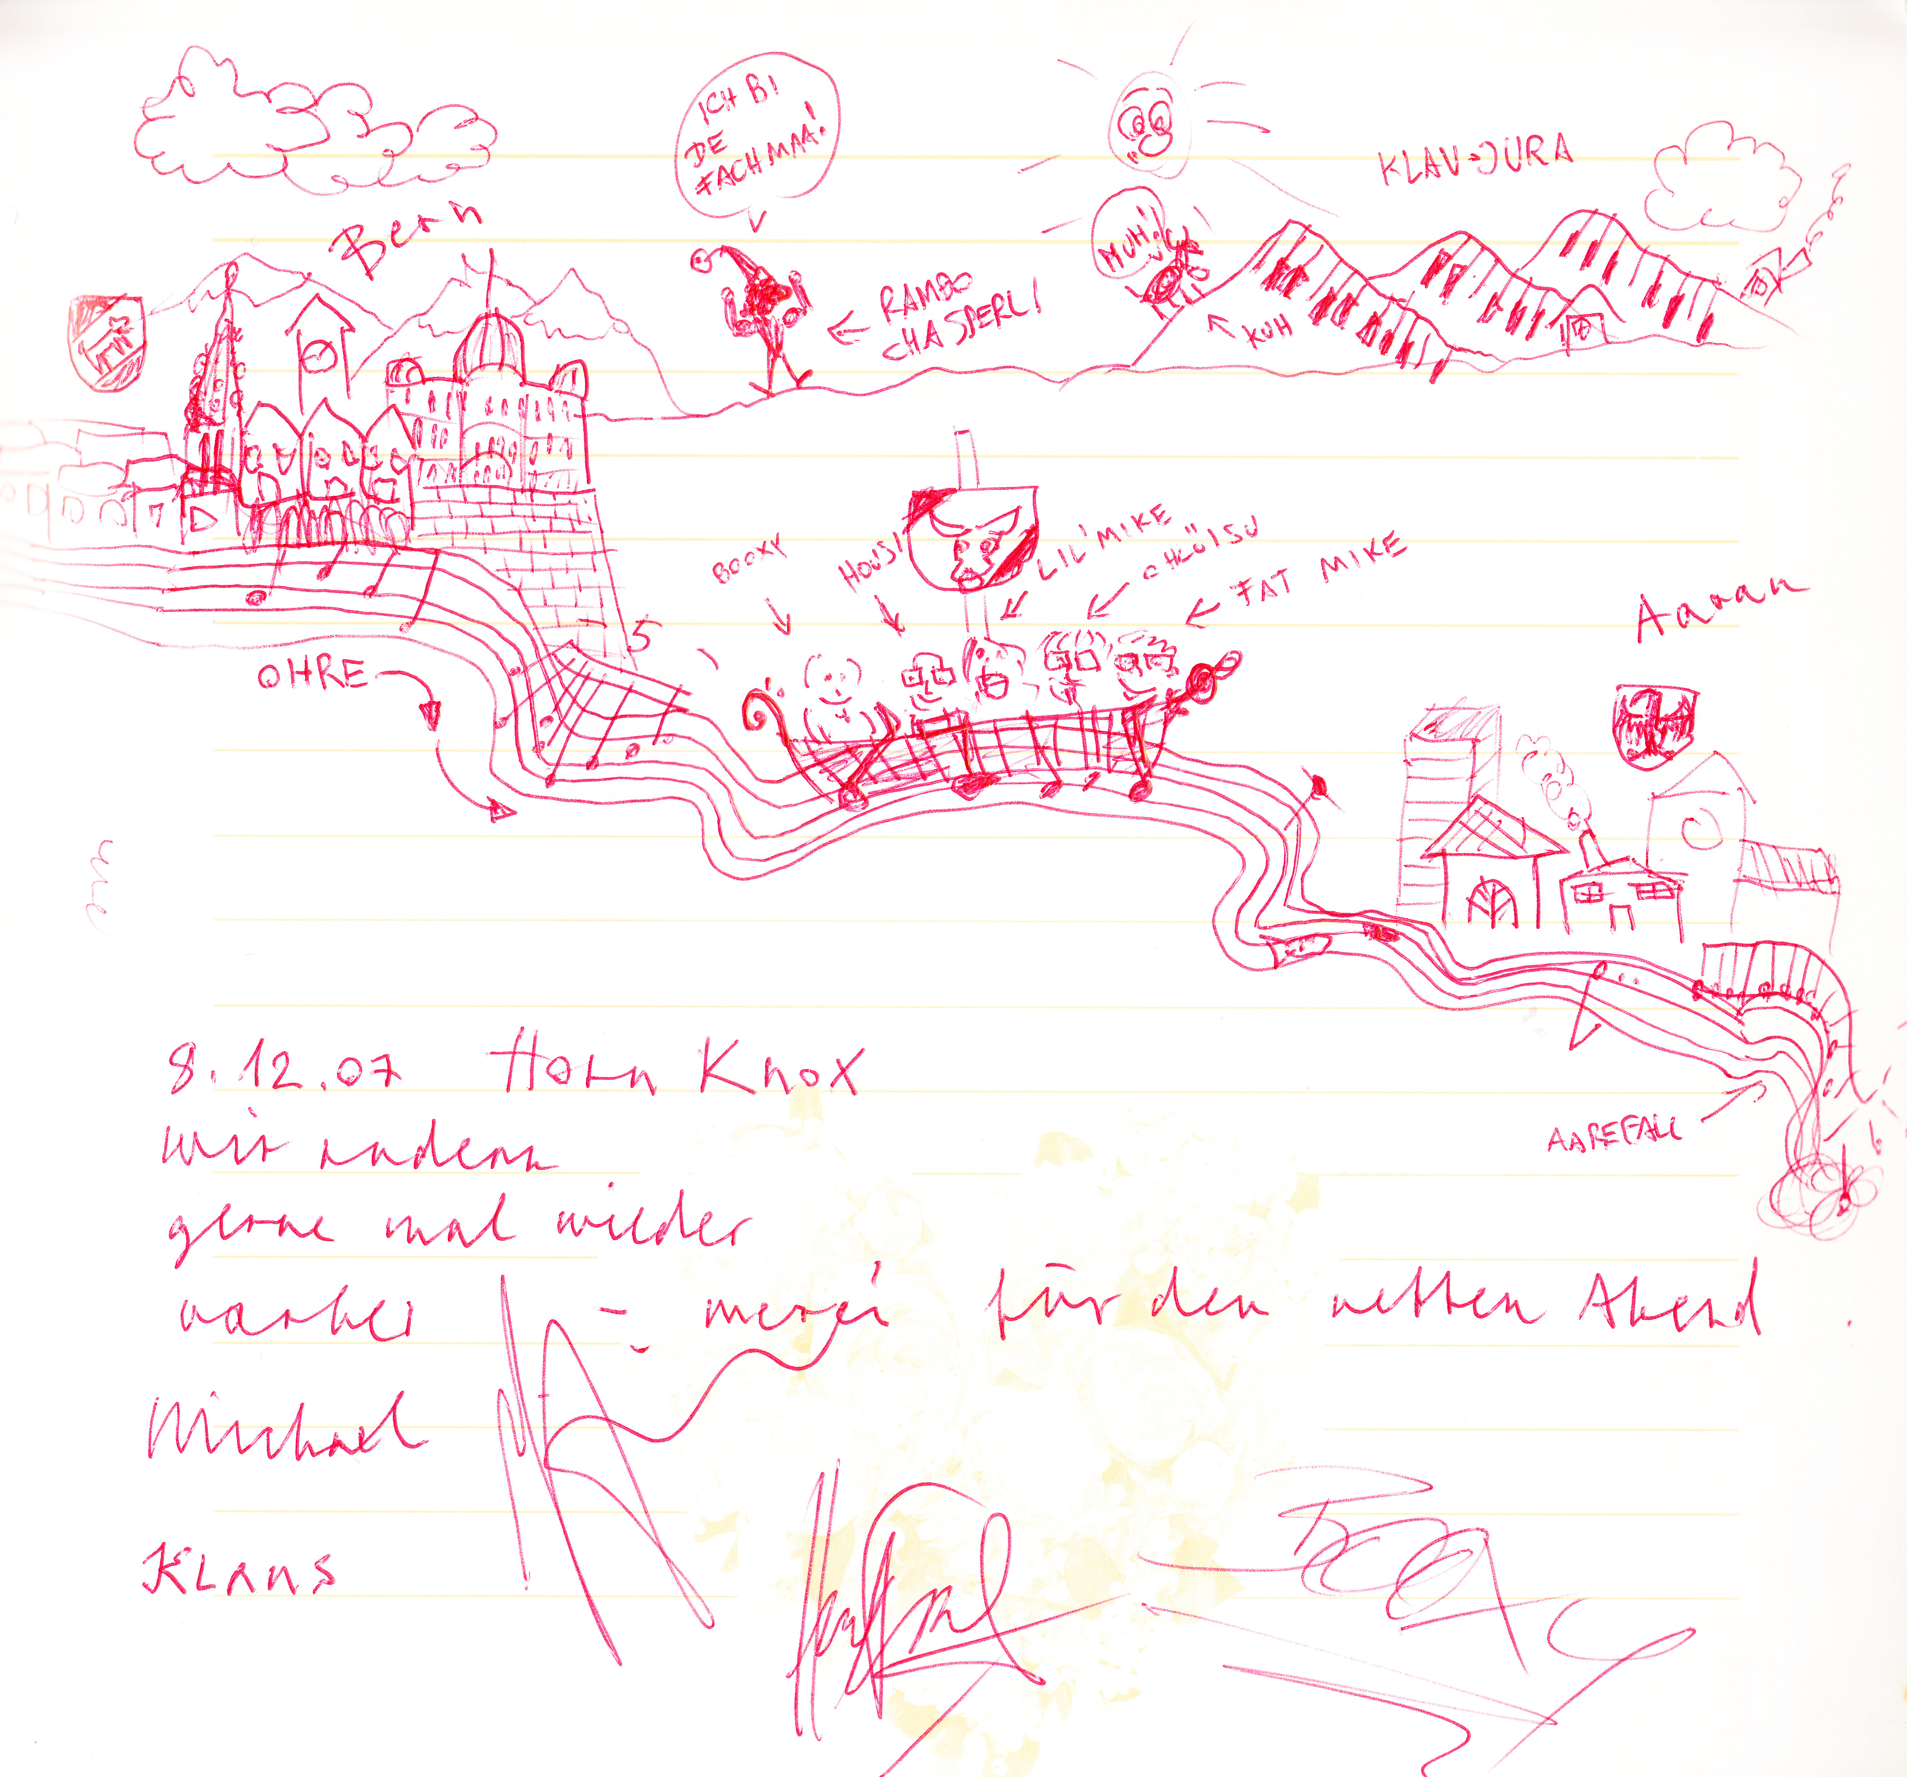
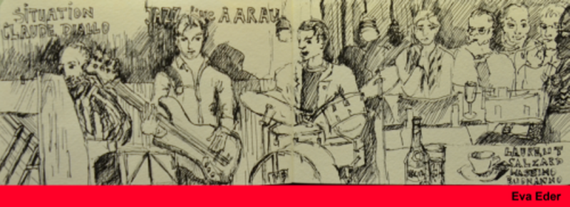


Class DisplayImage
Anything

